Slide 1

0
PBL PROJECT

Slide 2

REQUIREMENTS

Slide 3
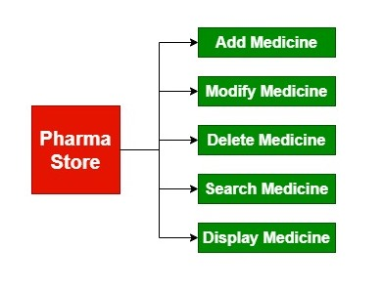
Design:-

Slide 4
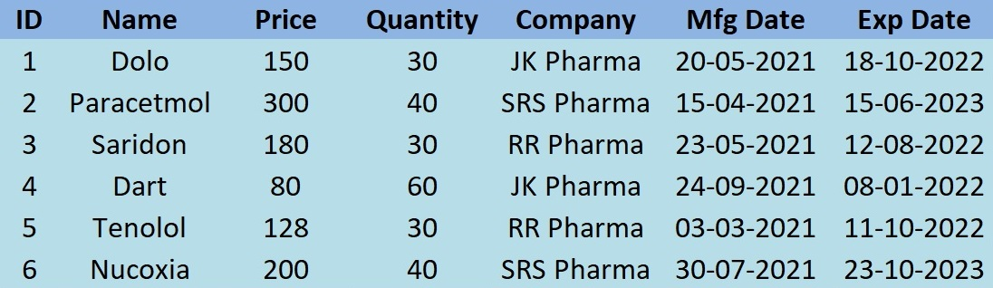
Example:-

Slide 5
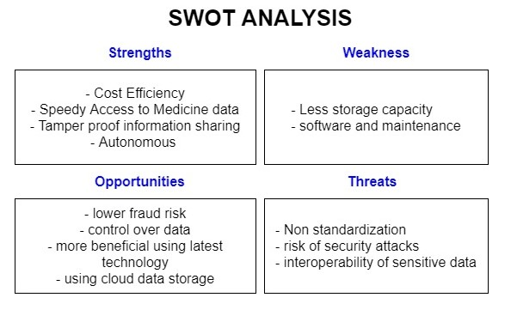

Slide 6
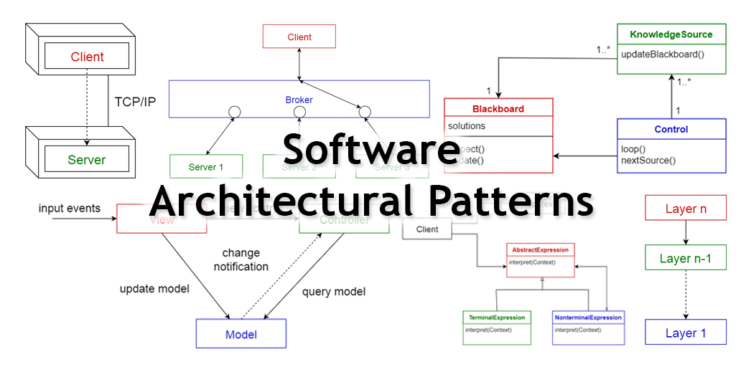

Slide 7
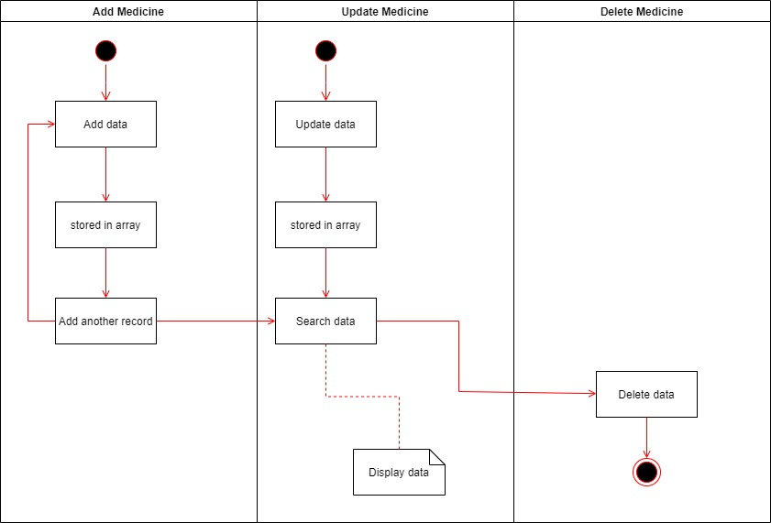
structure
structure
Activity Diagram

Slide 8
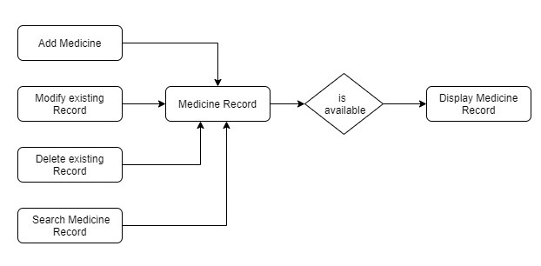
WORKING DIAGRAM

Slide 9
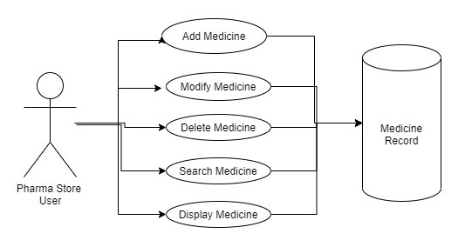
USE-CASE DIAGRAM

Slide 10


Slide 11
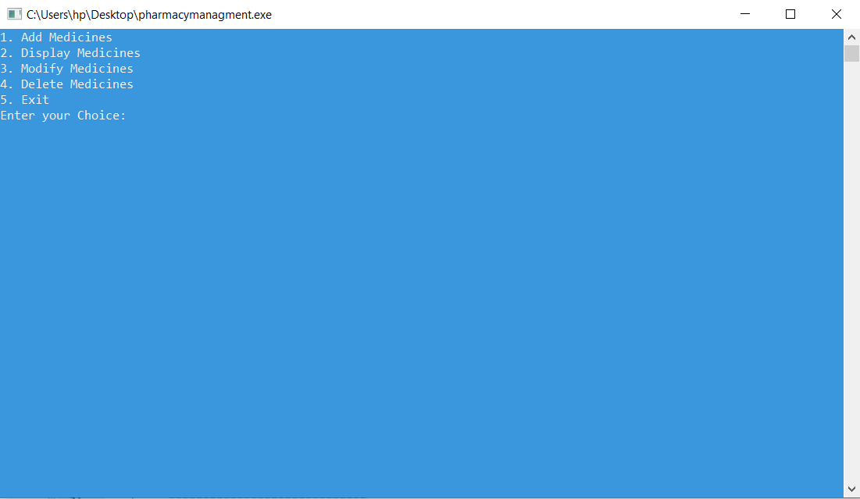

Slide 12
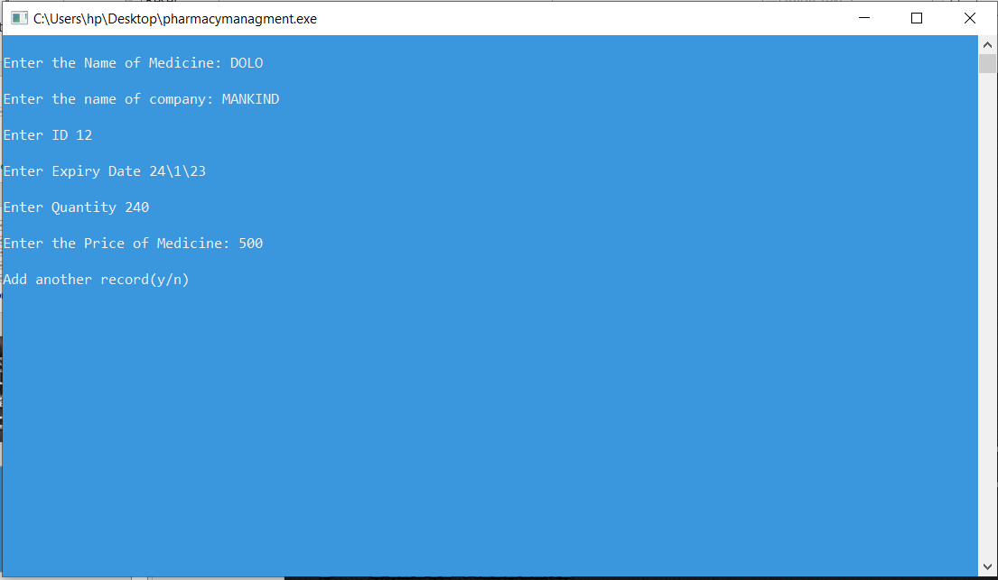

Slide 13
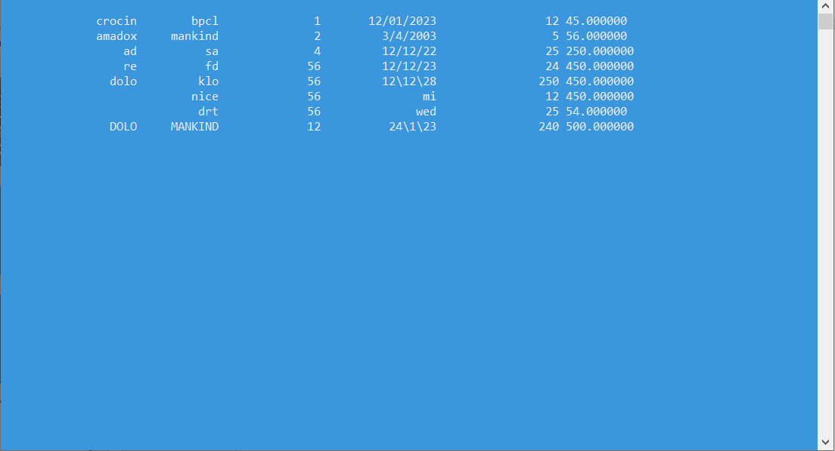

Slide 14


